Slide 1
Notepad (.txt)

Slide 2
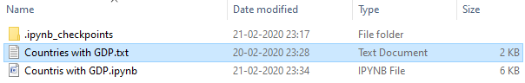
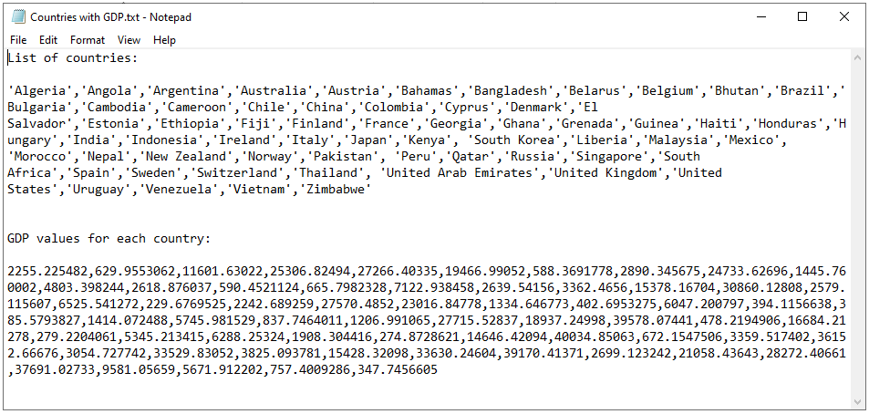

Slide 3
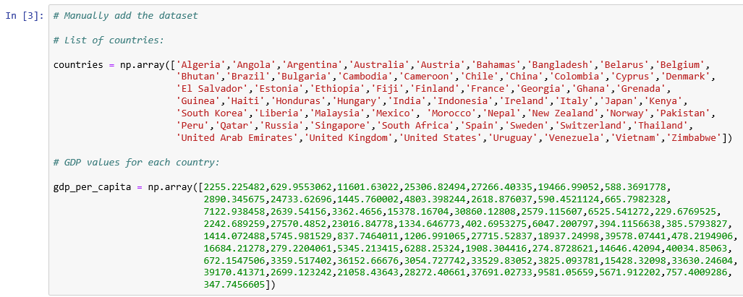
Manually copy and paste from Notepad to Jupyter

